Slide 1

CSE322 Lecture 8
Last time: - Decision procedures for automata and TMs
$A\text{DFA}$ , $A\text{NFA}$ , $E\text{DFA}$ , $EQ\text{DFA}$ ,
$A\text{TM}$ is T-recognizable
Today: (Sipser §4.2) - $A\text{TM}$ is undecidable
- The diagonalization method
- $\overline{A\text{TM}}$ is T-unrecognizable
- The reducibility method
- Other undecidable languages

Slide 2
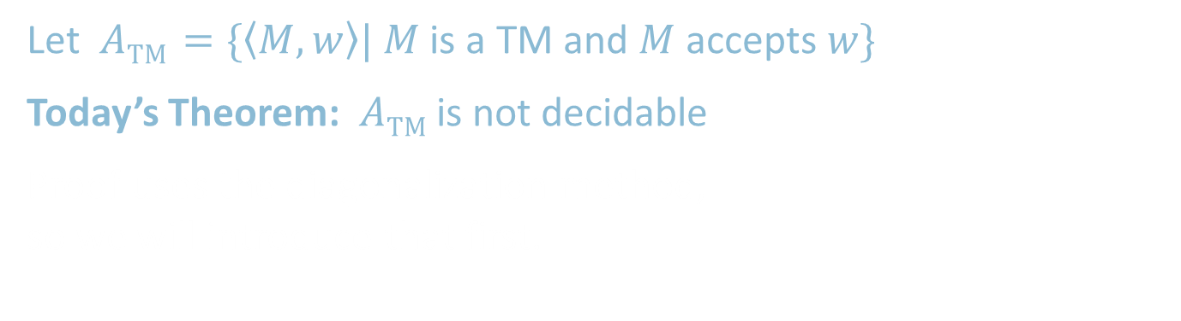
Recall: Acceptance Problem for TMs
Let $A\text{TM}$ $=\{〈M,w〉| M$ is a TM and $M$ accepts $w\}$
Today’s Theorem: $A\text{TM}$is not decidable
Proof uses the diagonalization method, so we will introduce that first.

Slide 3




The Size of Infinity
How to compare the relative sizes of infinite sets?
Cantor (~1890s) had the following idea.
Defn: Say that set $A$ and $B$ have the same size if there is a one-to-one and onto function $f:A→B$
Informally, two sets have the same size if we can pair up their members.
This definition works for finite sets.
Apply it to infinite sets too.
$$x≠y→$$
$$f\left(x\right)≠f\left(y\right)$$
“injective”
Range $(f)=B$ “surjective”
We call such an $f$ a 1-1 correspondence

Slide 4




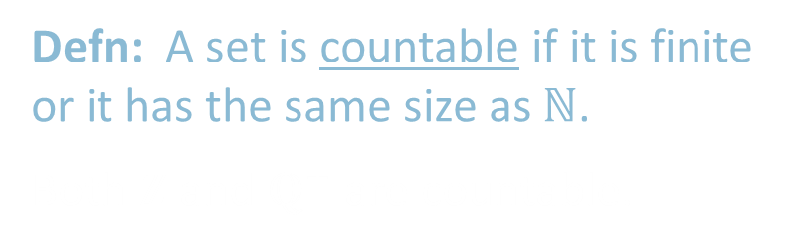


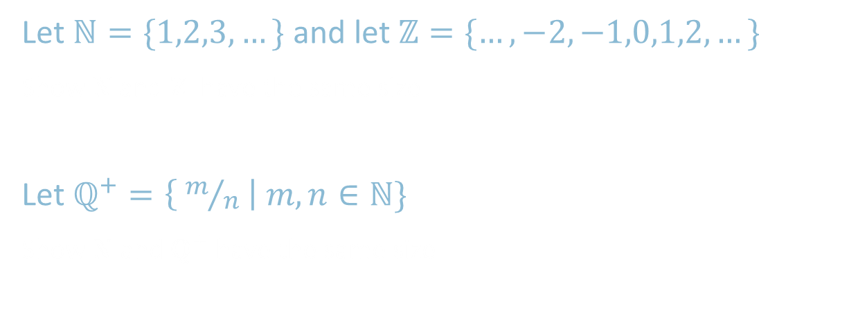

Countable Sets
Let $ℕ=\{1,2,3,…\}$ and let $ℤ=\{…,−2,−1,0,1,2,…\}$
Show $ℕ$and $ℤ$ have the same size
Let $ℚ^{+}=\left\{ m/n \right| m,n∈ℕ\}$
Show $ℕ$ and $ℚ^{+}$ have the same size
$$n$$ | $$f(n)$$
1 | 0
2 | -1
3 | 1
4 | -2
5 | 2
6 | -3
7 | 3
$⋮$ | $⋮$
$$ℕ$$
$$ℤ$$
$$n$$ | $$f(n)$$
1 | 1/1
2 | 2/1
3 | 1/2
4 | 3/1
5 | 3/2
6 | 2/3
7 | 1/3
$⋮$ | $⋮$
$$ℚ^{+}$$ | 1 | 2 | 3 | 4 | …
1 | 1/1 | 1/2 | 1/3 | 1/4
2 | 2/1 | 2/2 | 2/3 | 2/4 | …
3 | 3/1 | 3/2 | 3/3 | 3/4
4 | 4/1 | 4/2 | 4/3 | 4/4
$$⋮$$ |  | $$⋮$$
$$ℕ$$
$$ℚ^{+}$$
Defn: A set is countable if it is finite or it has the same size as $ℕ$.
Both $ℤ$ and $ℚ^{+}$ are countable.

Slide 5
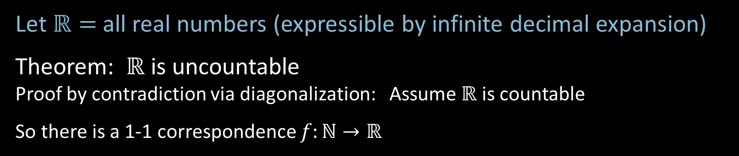



$ℝ$ is Uncountable – Diagonalization
Let $ℝ=$all real numbers (expressible by infinite decimal expansion)
Theorem: $ℝ$ is uncountable
Proof by contradiction via diagonalization: Assume $ℝ$ is countable
So there is a 1-1 correspondence $f:ℕ→ℝ$
$$n$$ | $$f(n)$$
1 | 2.718281828…
2 | 3.141592653…
3 | 0.000000000…
4 | 1.414213562…
5 | 0.142857242…
6 | 0.207879576…
7 | 1.234567890…
$⋮$ | $$⋮$$
Demonstrate a number $x∈ℝ$ that is missing from the list.
$x=$ 0.8516182…
differs from the $n$^{th} number in the $n$^{th} digit so cannot be the $n$^{th} number for any $n$.
Hence $x$ is not paired with any $n.$ It is missing from the list.
Therefore $f$ is not a 1-1 correspondence.
7
≠4
≠7
≠0
≠2
≠5
≠9
≠8
4
0
2
5
9
8
Diagonalization

Slide 6



$ℝ$ is Uncountable – Corollaries
Let $ℒ=$all languages
Corollary 1: $ℒ$ is uncountable
Proof: There’s a 1-1 correspondence from $ℒ$to $ℝ$ so they are the same size.
Observation: $Σ^{∗}=\{ε, 0,1,00,01,10,11,000, …\}$ is countable.
Let $ℳ=$all Turing machines
Observation: $ℳ$ is countable.
Because $\left\{〈M〉\right| M$ is a TM$\}⊆Σ^{∗}$.
Corollary 2: Some language is not decidable.
Because there are more languages than TMs.
We will show some specific language $A\text{TM}$ is not decidable.
$$Σ^{∗}$$ | {$ε$, | 0, | 1, | 00, | 01, | 10, | 11, | 000, | …
$$A∈ℒ$$ | { | 0, |  | 00, | 01, |  |  |  | …
$$f\left(A\right)$$ | .0 | 1 | 0 | 1 | 1 | 0 | 0 | 0 | …

Slide 7


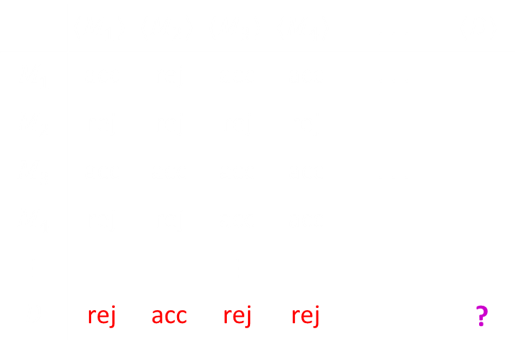
$A\text{TM}$ is undecidable
Recall $A\text{TM}$ $=\{〈M,w〉| M$ is a TM and $M$ accepts $w\}$
Theorem: $A\text{TM}$is not decidable
Proof by contradiction: Assume some TM $H$ decides $A\text{TM}$.
So $H$ on $〈M,w〉=\left\{\begin{aligned}\text{Accept} \text{if} M \text{accepts} w \\ \text{Reject} \text{if} \text{not} \end{aligned}\right.$
Use $H$ to construct TM $D$
$D=$“On input $〈M〉$
1. Simulate $H$ on input $〈M,〈M〉〉$
2. Accept if $H$ rejects. Reject if $H$ accepts.”
$D$ accepts $〈M〉$ iff $M$ doesn’t accept $〈M〉$ .
$D$ accepts $〈D〉$ iff $D$ doesn’t accept $〈D〉$ .
Contradiction.
Why is this proof a diagonalization?
All TMs
All TM descriptions:
 | $$〈M_{1}〉$$ | $$〈M_{2}〉$$ | $$〈M_{3}〉$$ | $$〈M_{4}〉$$ | . . . | $$〈D〉$$
$$M_{1}$$ | acc | rej | acc | acc | . . .
$$M_{2}$$ | rej | rej | rej | rej
$$M_{3}$$ | acc | acc | acc | acc | . . .
$$M_{4}$$ | rej | rej | acc | acc
$$⋮$$ |  |  | $$⋮$$
$$D$$ | rej | acc | rej | rej |  | ?
acc
rej
acc
acc

Slide 8




$\overline{A\text{TM}}$ is T-unrecognizable
Theorem: If $A$ and $\overline{A}$ are T-recognizable then $A$ is decidable
Proof: Let TM $M_{1}$ and $M_{2}$ recognize $A$ and $\overline{A}$.
Construct TM $T$ deciding $A$.
$T=$ “On input $w$
1. Run $M_{1}$ and $M_{2}$ on $w$ in parallel until one accepts.
2. If $M_{1}$ accepts then accept. If $M_{2}$ accepts then reject.”
Corollary: $\overline{A\text{TM}}$ is T-unrecognizable
Proof: $A\text{TM}$ is T-recognizable but also undecidable
Complement of T-recognizable = co-T-recognizable
T-recognizable
$$\overline{A\text{TM}}$$
$A\text{TM}$
decidable

Slide 9

The Reducibility Method
Use our knowledge that $A\text{TM}$ is undecidable to show other problems are undecidable.
Defn: $HALT\text{TM}$ $=\left\{〈M,w〉\right| M$halts on input $w\}$
Theorem: $HALT\text{TM}$ is undecidable
Proof by contradiction, showing that $A\text{TM}$ is reducible to $HALT\text{TM}$:
Assume that $HALT\text{TM}$ is decidable and show that $A\text{TM}$ is decidable (false!).
Let TM $R$ decide $HALT\text{TM}$.
Construct TM $S$ deciding $A\text{TM}$.
$S=$ “On input $〈M,w〉$
1. Use $R$ to test if $M$ on $w$ halts. If not, reject.
2. Simulate $M$ on $w$ until it halts (as guaranteed by $R$).
3. If $M$ has accepted then accept. If $M$ has rejected then reject.
TM $S$ decides $A\text{TM}$, a contradiction. Therefore $HALT\text{TM}$ is undecidable.

Slide 10

Quick review of today
Showed that $ℕ$ and $ℝ$ are not the same size to introduce the Diagonalization Method.
$A\text{TM}$ is undecidable.
If $A$ and $\overline{A}$ are T-recognizable then $A$ is decidable.
$\overline{A\text{TM}}$ is T-unrecognizable.
Introduced the Reducibility Method to show that $HALT\text{TM}$ is undecidable.

